Slide 1



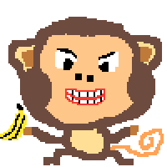
MonkeyDefence
By: Ethan Ling and Kevin Chu
Notes:
Both of us

Slide 2
Team Overview
Let’s start with us
Notes:
ethan

Slide 3
Team Overview
Team Name: MonkeyDefence
Team Number: 4
Ethan
Enemy and Collision
Kevin
Player and Projectiles
Notes:
ethan

Slide 4
2. Project Overview
What are they doing?
Notes:
kevin

Slide 5
Introduction
Our program is a game where you play as a monkey destroying the enemy (Gorillos) with a multitude of weapons.
Bananas, Coconuts, Poop
Anyone who wants to have a fun time with hilarious graphics or wants to test their skills in shooting/navigation should play this game.
Our game features keyboard input, an AI for the enemies, buttons to choose/buy weapons, and a graphics window which the player can use to play.
Notes:
kevin

Slide 6
3. Code Overview
Notes:
ethan

Slide 7
Classes
Banana - The subclass of Weapon, low damage
Coconut - The subclass of Weapon, medium damage
Enemy - Represents the entities the player must destroy
Main - Where all the graphics are created (main method located)
MovingImage - Helps with movement and animations
Player - Represents the entity the player controls
Poop - The subclass of Weapon, high damage
SplashScreen - Represents the splash screen shown at launch
Weapon - Represents the weapons the player uses
SmartEnemy - Subclass of enemy, which follows the player
CrazyEnemy = Subclass of enemy, doesn’t follows the player
Notes:
ethan

Slide 8
2 hardest problems to solve
Weapon/Enemy Movement
The Weapon class was hard to code as we had to use physics to calculate a weapon’s velocity and direction if it were to target a certain point. This was same with the enemies, as the enemies had to constantly target the player
Keeping Track of Multiple Enemies
We had to figure out why we could not get the player to shoot two bananas at two seperate enemies. Eventually, we figured out that this was an ArrayList error.
Notes:
kevin

Slide 9
Controls
Input | Action
W | Move Up
A | Move Left
S | Move Down
D | Move Right
[ MOUSE CLICK ] | Shoot / Select Weapon
Notes:
kevin

Slide 10
RUN IT YOURSELF !
http://bit.ly/MonkeyDefence
Notes:
ethan

Slide 11
DISCUSSION TIME!
Notes:
ethan

Slide 12
Next Steps
Add more weapons and power ups
Make the UI look nicer
Add more types of enemies
Sound Effects
Notes:
ethan

Slide 13
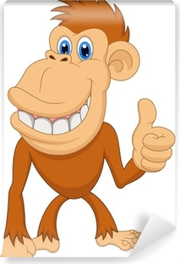

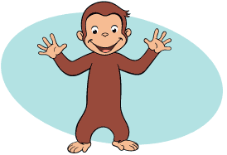
Thanks for Listening!
Notes:
kevin

Slide 14

Questions?
Notes:
kevin

